Slide 1
Use Case Documents

Slide 2
What are they?
Written documentation of different scenarios of how a user might interact with their system, including specific goals and others that might be involved in order to make it happen
Documentation is written with text rather than diagrams, so it is useful for explaining to others with a less technological-oriented background

Slide 3
Things to include
Name of use case
Brief description of the use case
Actors involved in the use case – any people or external systems that take part
Preconditions – What must be true before the use case can happen?
Basic flow – the steps taken to accomplish the goal
Alternate flows – any other ways the same goal can be accomplished
Exception flows – Things that can happen that cause errors, or prevent the goal from being accomplished
Post Conditions – What is true when the use case is finished

Slide 4
You can, of course, include more items should your tests require additional notes, these are just some of the basic items that use case documentation will include

Slide 5
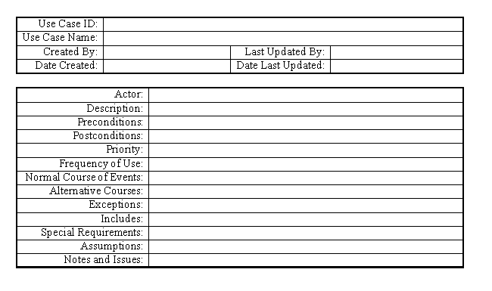
Sample use case document templates

Slide 6
